Slide 1



Atliq Hardwares
Consumer Goods AD-HOC Insights
By- Kiran Sodheja

Slide 2
Objective
Atliq Hardwares (imaginary company) is one of the leading computer hardware producers in India and well expanded in other countries too.
However, the management noticed that they do not get enough insights to make quick and smart data-informed decisions.
They want to expand their data analytics team by adding several junior data analysts. Tony Sharma, their data analytics director wanted to hire someone who is good at both tech and soft skills.
Hence, he decided to conduct a SQL challenge which will help him understand both the skills.
Problem:
- There are 10 ad hoc requests for which the business needs insights.
Approach:
- Run a SQL query to answer these requests.

Slide 3
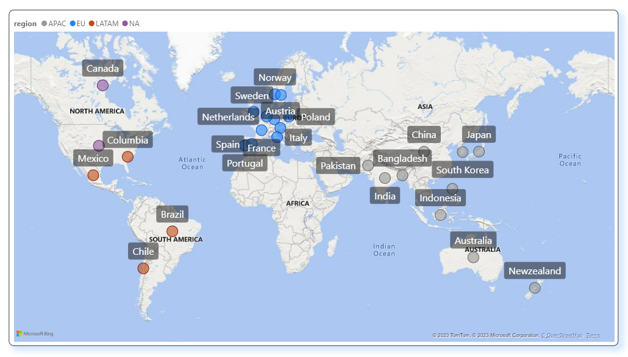
Atliq's Market

Slide 4
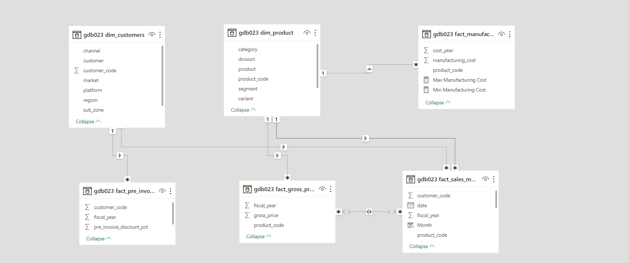



Data And Tools

Slide 5
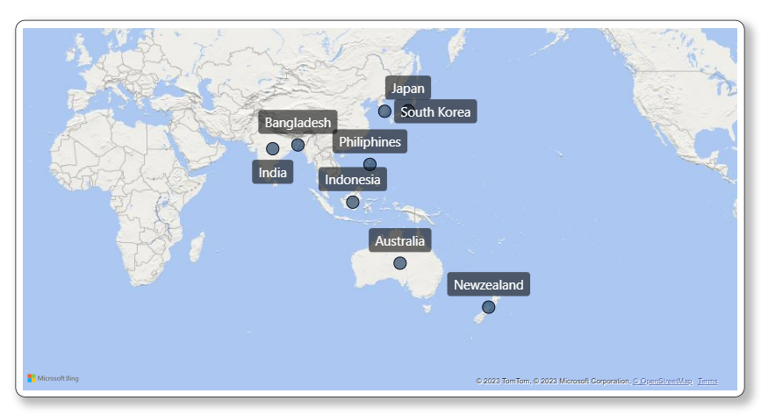
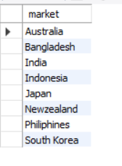
Provide the list of markets in which customer "Atliq Exclusive" operates its business in the APAC region.
Insights:
Atliq Exclusive's has 8 Marketing Countries in the APAC Region

Slide 6
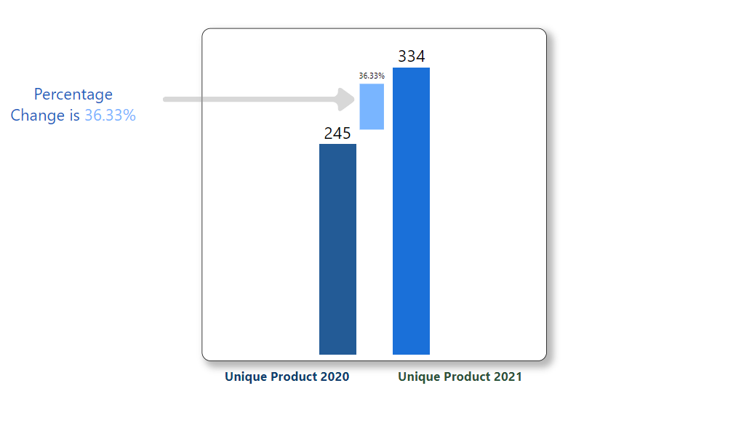

2. What is the percentage of unique product increase in 2021 vs. 2020? The final output contains these fields,
unique_products_2020
unique_products_2021
percentage_chg
Insights:
In FY 2020,we had a total products count of 245,but in FY 2021 there were 334,our
Product count increased by 36% in one year.

Slide 7
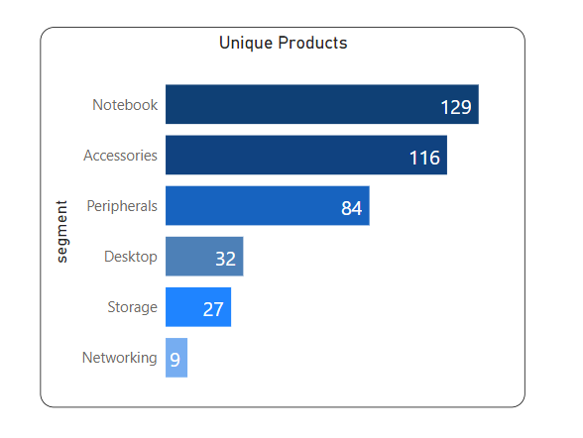
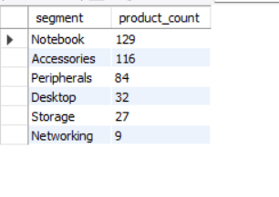
3. Provide a report with all the unique product counts for each segment and sort them in descending order of product counts. The final output contains 2 fields,
segment
product_count
Insights:
Atliq’s Hardware Provides a wide range of products under the segment
Notebook, Accessories and Peripherals. However, we still need to expand our production
under the Desktop, Storage and Networking segment.

Slide 8
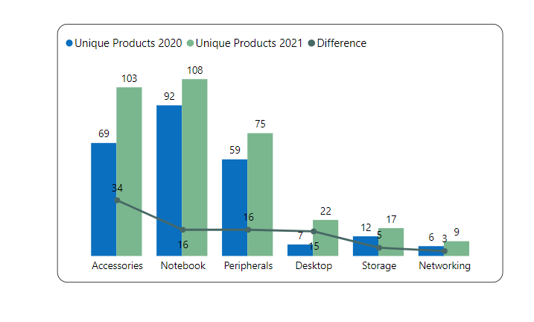
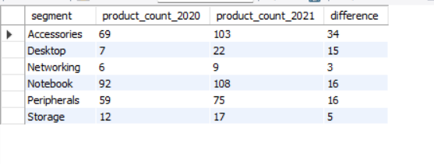
4. Follow-up: Which segment had the most increase in unique products in 2021 vs 2020? The final output contains these fields,
segment
product_count_2020
product_count_2021
Difference
Insights:
Accessories and Notebook had largest increase in production whereas Networking and Storage are
Growing at a slower pace than other segment.

Slide 9
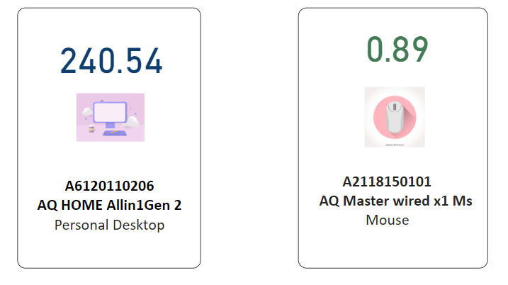
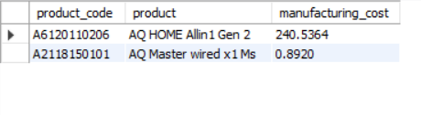
5. Get the products that have the highest and lowest manufacturing costs. The final output should contain these fields,
product_code
product
manufacturing_cost
Insights:
Personal Desktop: AQ HOME Allin1 Gen 2 has the highest manufacturing cost.
Mouse: AQ Master wired ×1 Ms has the lowest manufacturing cost

Slide 10
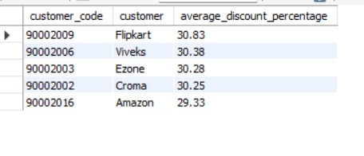
6. Generate a report which contains the top 5 customers who received an average high pre_invoice_discount_pct for the fiscal year 2021 and in the Indian market. The final output contains these fields,
customer_code
customer
average_discount_percentage
1
Flipkart
2
Viveks
3
Ezone
4
Croma
Insights:
The largest Pre-invoice Average Discount Percentage was given to Flipkart
The least Pre-invoice Average Discount Percentage was given to Amazon
5
Amazon

Slide 11
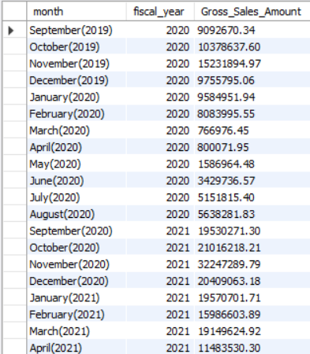

7. Get the complete report of the Gross sales amount
for the customer “Atliq Exclusive”
for each month. This analysis helps to get an
idea of low and high-performing
months and take strategic decisions.
The final report contains these columns:
Month
Year
Gross sales Amount
Insights:
The highest gross sales total for both fiscal years
is in November (2020)
The lowest gross sales total for both fiscal years
Is in March (2020)

Slide 12
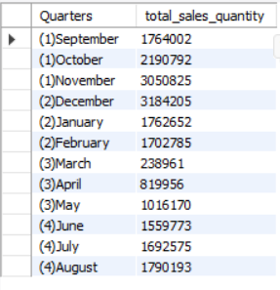
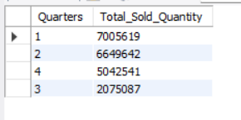
8. In which quarter of 2020, got the maximum total_sold_quantity? The final output contains these fields sorted by the total_sold_quantity,
Quarter
total_sold_quantity
Insights:
Quarter 1 has the maximum total sold quantity of 7.01M,whereas
the total sold quantity decreased to 2.08 M in Quarter 3 which was
In March, April and May.

Slide 13
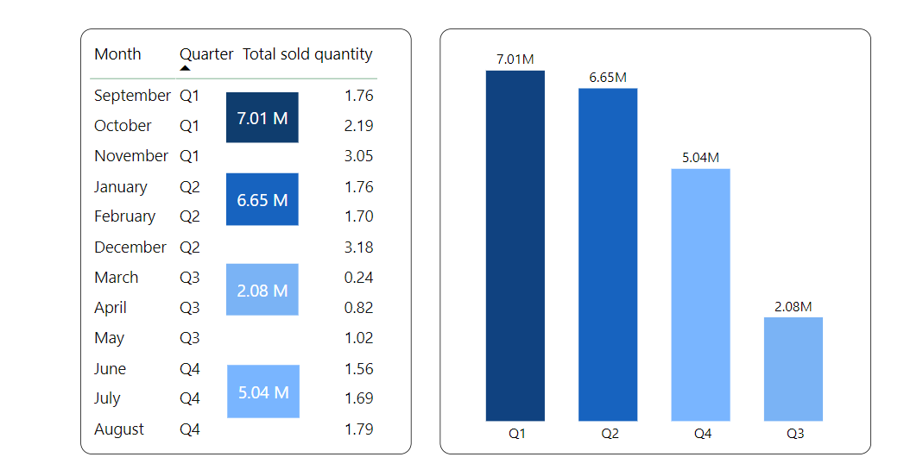

Slide 14
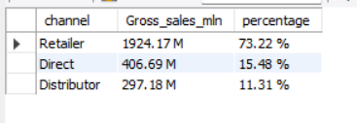
9. Which channel helped to bring more gross sales in the fiscal year 2021 and the percentage of contribution? The final output contains these fields,
channel
gross_sales_mln
Percentage
Insights:
Channel: Retailer bring maximum sales percentage for the company with contribution of:73.22%
Channel :Distributor bring minimum sales percentage for the company with contribution
Of 11.31%.

Slide 15
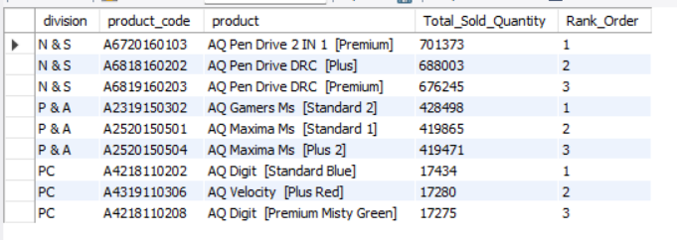
10. Get the Top 3 products in each division that have a high total_sold_quantity in the fiscal_year 2021? The final output contains these fields,
division
product_code
product
total_sold_quantity
rank_order
Insights:
Each division has a product with different variant that appears twice in the top three products

Slide 16
